Slide 1
Capstone Project : Movie Rental Analysis

Slide 2
Objective : The objective of this project is to create a comprehensive Power BI dashboard using the Sakila DVD Rental Store Database, providing valuable insights into the rental store business.
Analysis Scope : The analysis will focus on customer behaviour, film inventory management, staff performance, and store operations.
Goal : . The goal is to enable data-driven decision-making and improve overall business performance. The Power BI dashboard will offer insights into customer segmentation, sales trends, film performance, staff productivity, and store revenue. The primary aim is to optimize film inventory, enhance customer satisfaction, improve staff performance, and streamline store operations.

Slide 3
Power BI Questions

Slide 4
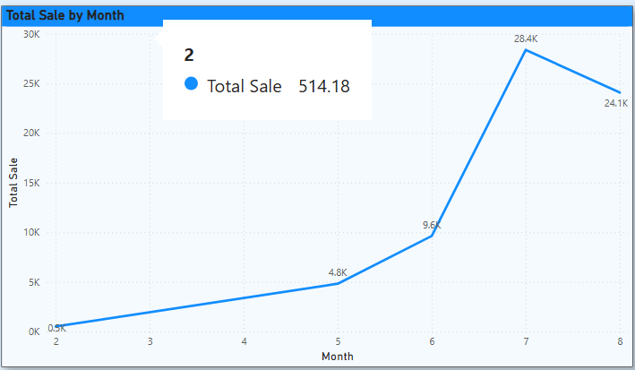
1. How does the sales revenue vary by month?
Conclusion : Sales revenue shows a consistent upward trend from month 2 to month 7, peaking at 28.4K. However, there is a slight decline in month 8 to 24.1K.

Slide 5
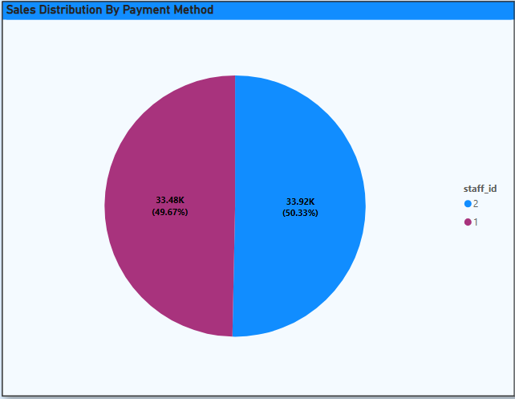
2. What is the distribution of sales by payment method?
Conclusion:
Sales are almost evenly distributed between the two payment methods, with staff ID 2 accounting for 50.33% and staff ID 1 for 49.67% of total sales.

Slide 6
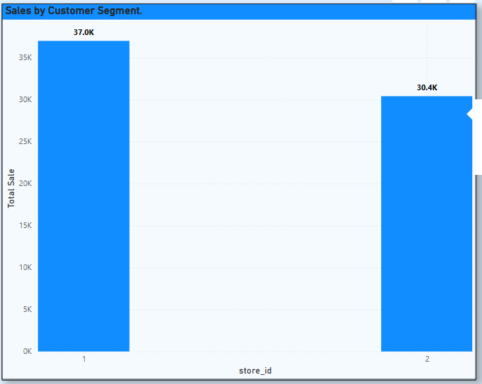
3. Which customer segments generate the highest sales?
Conclusion:
Customer segment associated with store ID 1 generates the highest sales, totaling 37.0K, compared to 30.4K from store ID 2.

Slide 7
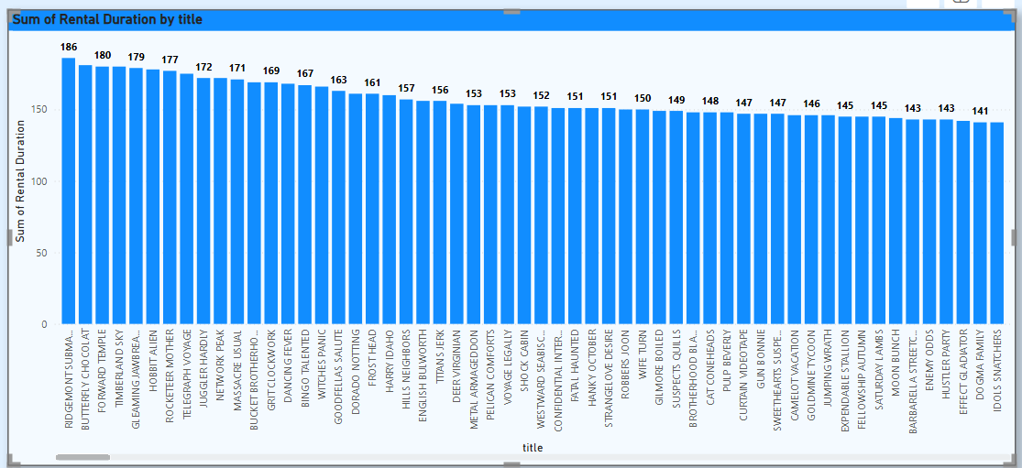
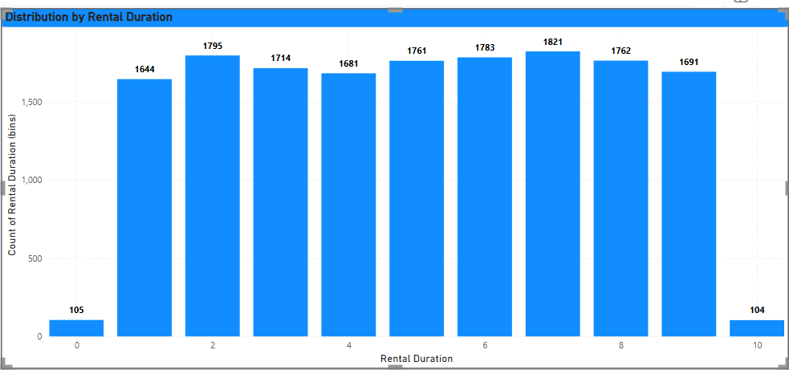
4. What is the distribution of films by rental duration?
Conclusion:
Rental duration varies across films, with "RIDGEMONT SUBMARINE" having the highest rental duration at 186. Most films have rental durations between 150 and 180, indicating a relatively consistent level of customer engagement.

Slide 8
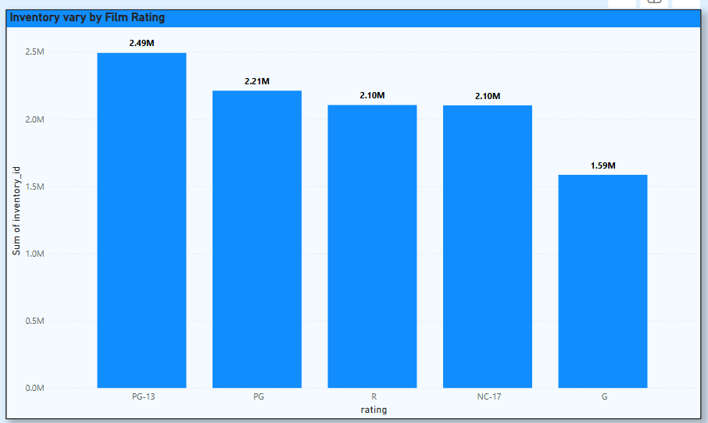
5. How does the inventory vary by film rating?
Conclusion: Inventory levels vary by film rating, with PG-13 films having the highest inventory (2.49M), followed by PG, R, and NC-17 films. G-rated films have the lowest inventory at 1.59M, indicating a stronger focus on PG-13 content

Slide 9
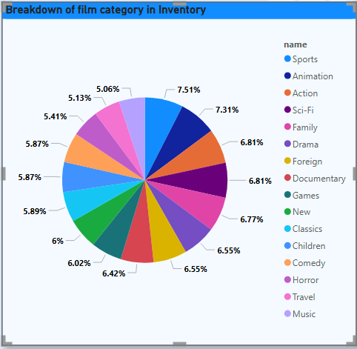
6. What is the breakdown of film categories in the inventory?
Conclusion: The inventory is distributed across various film categories, with Sports, Animation, and Action being the most stocked categories. Sports leads with the highest count (344), followed closely by Animation (335) and Action (312). Music and Travel categories have the lowest inventory counts, indicating lower representation.

Slide 10
7. What is the distribution of staff by employment duration?
Data is not available.

Slide 11
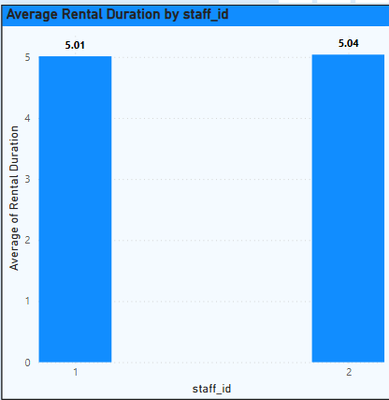
9. What is the average rental duration by staff member?
Conclusion :
The average rental duration for
staff_id 1 is 5.01, and for staff_id 2 it is 5.04. This indicates that both
staff members have similar average rental durations, with staff_id 2 having a
slightly higher average. The data suggests no significant difference in rental
duration handling between the two staff members.

Slide 12
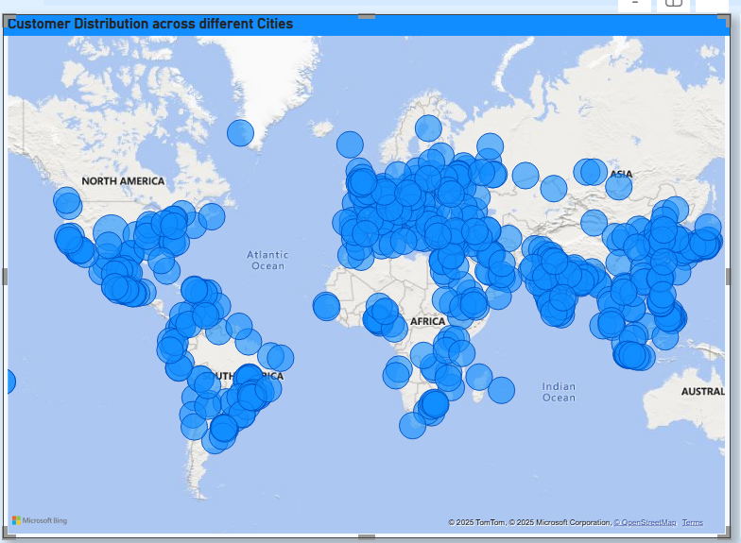
10. What is the distribution of customers across different cities?
Conclusion:
The data indicates that customers are spread across multiple continents, with notable presence in North America, Asia, and Australia. The lack of granularity makes it difficult to assess concentration trends.

Slide 13
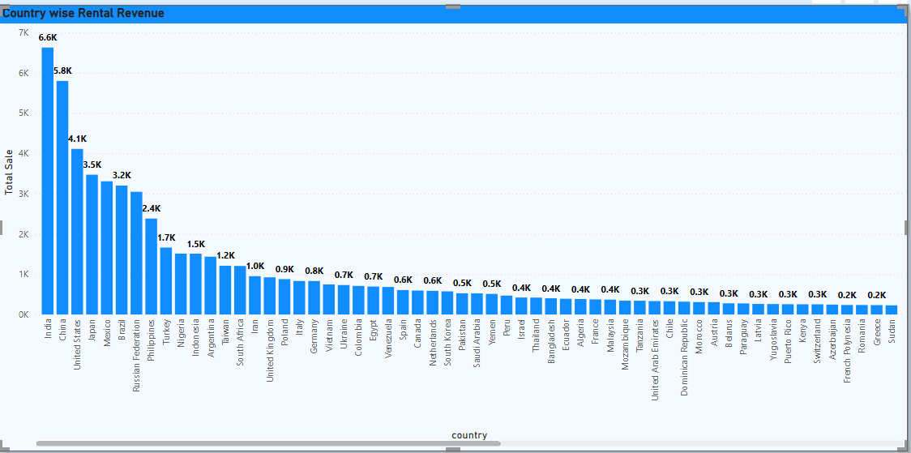
11. How does the rental revenue vary by country?
Conclusion :
Rental revenue varies significantly across different countries, with a high concentration in the top three. India is the leading country, generating the highest rental revenue at $6.6K, followed by China ($5.8K) and the United States ($4.1K). After these top performers, there is a sharp decline in revenue, with a long tail of numerous countries contributing substantially smaller amounts.

Slide 14
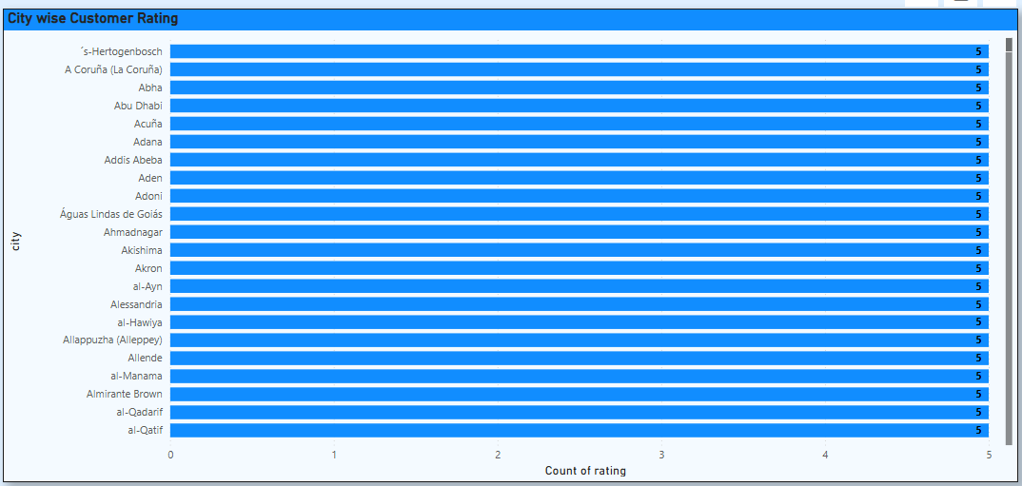
12. Which locations have the highest and lowest customer ratings?
Conclusion :
A large number of cities have received the highest possible customer rating of 5. This includes diverse locations such as 's-Hertogenbosch, A Coruña, Abu Dhabi, and Ahmadnagar, among many others.

Slide 15
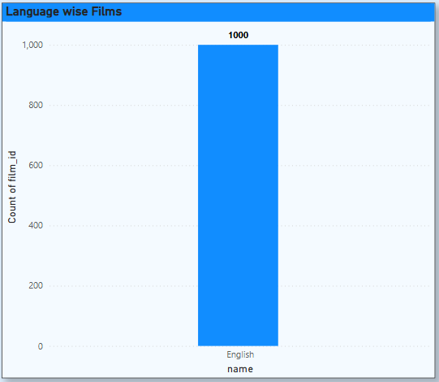
13. What is the distribution of films by language?
Conclusion :
The distribution of films is concentrated in a single language. All 1,000 films in this dataset are exclusively in English.

Slide 16
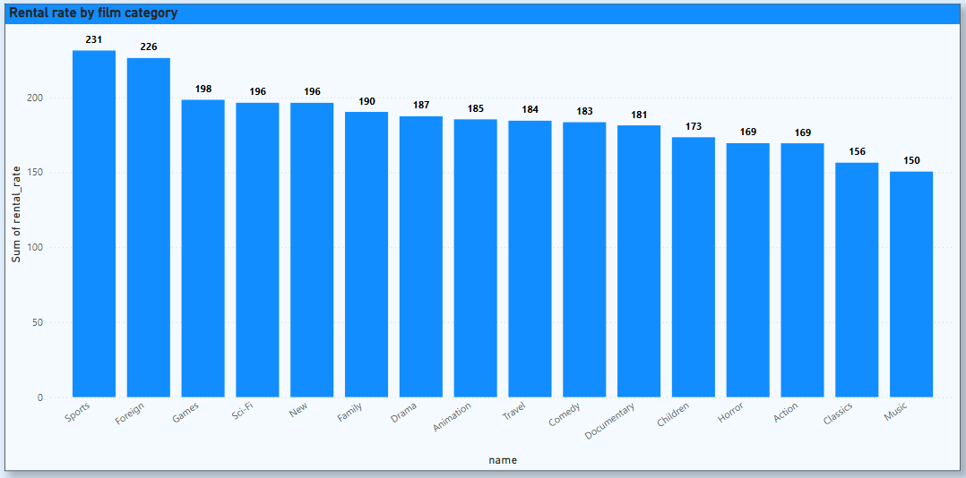
14. Which film categories have the highest rental rates?
Conclusion : The Sports category has the highest rental rate, with a total sum of 231. It is followed closely by the Foreign (226) and Games (198) categories. Conversely, the Music category has the lowest rental rate among those shown, with a sum of 150.

Slide 17
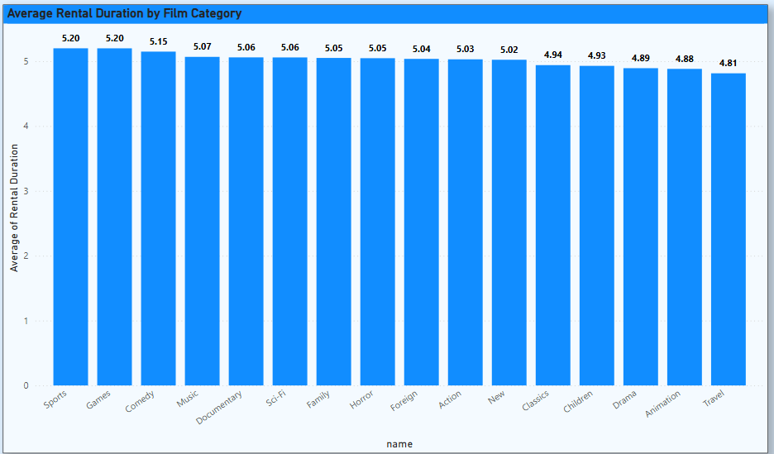
15. How does the average rental duration vary by film category?
Conclusion :
The average rental duration varies only slightly by film category. Sports and Games have the highest average rental durations (5.20 days), while Travel has the lowest (4.81 days). Overall, the difference between categories is minimal, indicating that rental duration is fairly consistent regardless of film category.

Slide 18
EDA Questions

Slide 19
1. What are the purchasing patterns of new customers versus repeat customers?
Repeat customers, on the other hand, show a strong preference for the Sports, Animation, and Action genres. Notably, the volume of rentals from repeat customers is significantly higher than that of new customers, indicating a loyal customer base for these genres.
Rental Frequency : On average, a customer rents a film every 5.08 days. This suggests a consistent pattern of engagement with the rental service. In Summary: Spending Habits: New and repeat customers have similar spending habits on a per-rental basis. Genre Loyalty: Repeat customers exhibit strong preferences for specific genres, particularly Sports and Action, and are the main drivers of rental volume . Engagement: The average rental frequency of approximately 5 days indicates a healthy and regular engagement from the customer base.

Slide 20
2. Which films have the highest rental rates and are most in demand?
Fixed Rental Rate: All films in this dataset have a fixed rental rate of $4.99. This means that the revenue generated is directly proportional to the number of times a film is rented. Strong Positive Correlation between Rentals and Revenue: As expected with a fixed rental rate, there is a strong, direct, and positive correlation between the total number of rentals and the total revenue generated. The more a film is rented, the more revenue it generates. This linear relationship is visualized in the scatter plot below . Top Performing Films: The most popular films are also the highest-grossing ones. The film "WIFE TURN" stands out as the top performer in both categories.
Data Visualizations: 1. Top 10 Films by Total Revenue
This chart showcases the films that have generated the most revenue. "WIFE TURN" is the clear leader, followed by "TELEGRAPH VOYAGE" and "ZORRO ARK".
2. Top 10 Films by Total Rentals
This chart highlights the most frequently rented films. "WIFE TURN" is again at the top, indicating its high popularity.
3. Total Rentals vs. Total Revenue
This scatter plot clearly illustrates the direct relationship between the number of rentals and the revenue generated. Each point on the plot represents a film, and the upward trend shows that as the number of rentals increases, the revenue increases as well.

Slide 21
3. Are there correlations between staff performance and customer satisfaction?
Performance Comparison
Revenue
Jon Stephens generated $266 more revenue than Mike despite handling 19 fewer rentals.
This suggests Jon handles higher-value transactions.
Customer Satisfaction
Jon has slightly higher satisfaction (4.21 vs 4.16), indicating better service quality.
Efficiency (Revenue per Rental)
Mike: ~$4.16 per rental
Jon: ~$4.21 per rental (higher efficiency)
Actionable Insights
1. Best Performer: Jon Stephens is more efficient and slightly better in customer satisfaction.
2. Improvement for Mike Hillyer:
Needs training on upselling & handling premium rentals.
Can adopt Jon’s customer service techniques (e.g., personalized recommendations).
3. Knowledge Sharing: Encourage Jon to mentor Mike to raise average revenue per rental.
4. Incentives: Both are high performers; introduce incentive programs to maintain motivation.

Slide 22
4. Are there seasonal trends in customer behaviour across different locations?
Store 2 consistently outperforms Store 1: Avg Revenue: Store 2 ≈ $9.8k vs Store 1 ≈ $2.7k
Customer Base: Store 2 has ~30% more unique customers.
Store 1 has lower revenue per transaction, suggesting weaker pricing or customer mix.
2. Seasonality & Growth Patterns
Revenue Growth: Sharp growth between May–July 2005, peak in July, decline afterwards.
Suggests a seasonal peak in mid-year (possibly summer demand).
Customer vs Transaction Pattern: High transactions but relatively low unique customers → many repeat purchases by the same customers.
3. Efficiency Metrics
Store 1 Weakness: Revenue per customer is low (~$8–10) → customers are either price- sensitive or product mix is low-margin.
Store 2 Strength: Higher revenue per customer (~$15+) → better upselling/cross-selling.

Slide 23
5. Are certain language films more popular among specific customer segments?
Data is insufficient to solve.

Slide 24
6. How does customer loyalty impact sales revenue over time?
Low Loyalty Segment
Contributes minimally to overall revenue (less than 0.2% of total).
Only two months of data, both with very low revenue (under 50).
Medium Loyalty Segment
Dominates revenue, generating over $56,000 across five recorded months.
Monthly revenue shows a sharp increase through 2005:
May 2005: $4,101.13
June 2005: $8,149.28
July 2005: $23,761.60 (peak)
August 2005: $20,370.85
February 2006: $429.49 (steep drop)
After peaking in mid-2005, revenue drops precipitously by February 2006, possibly indicating loss of mid-tier customers or seasonality.
Observations
The bulk of earnings depends on Medium Loyalty customers, underscoring their importance.
Revenue volatility in Medium Loyalty is significant and should be explored; the late decline could warrant targeted retention strategies.
Low Loyalty customers contribute little and may require cost-benefit analysis before investment in acquisition or retention.
Recommendations
Focus retention and upselling efforts on the Medium Loyalty group to prevent future drop-offs.
Investigate reasons for revenue decline post-2005 among Medium Loyalty customers.
Consider segment-specific strategies: resource allocation for Low Loyalty may not be justifiable compared to potential returns.

Slide 25
7. Are certain film categories more popular in specific locations?
Genre Insights
This analysis reveals which movie genres are the most popular among customers.
Top 10 Most Popular Movie Genres
This chart displays the top 10 genres based on the total number of rentals.
Most Popular Genres: 'Documentary', 'Animation', and 'Action' are the top three most rented genres.
Other Popular Genres: 'Sports', 'Sci-Fi', and 'Foreign' also feature in the top 10, indicating a diverse range of interests among customers.
Geographical Insights
This section focuses on where your customers are located and which countries contribute the most to your rental numbers.
Top 10 Countries by Total Rentals
Top Markets: India, China, and the United States are your top three markets, with significantly more rentals than other countries.
Emerging Markets: Mexico and Japan also represent substantial markets for your business. The remaining countries in the top 10 have a smaller, but still significant, number of rentals.

Slide 26
8. How does the availability and knowledge of staff affect customer ratings?
Staff Performance Comparison
The analysis focuses on several key performance indicators to provide a comprehensive view of each staff member's contribution.
Total Rentals by Staff Member
Mike Hillyer has a slightly higher number of total rentals (8,040) compared to Jon Stephens (8,004). This indicates that Mike is handling a marginally higher volume of transactions.
Average Film Price by Staff Member
The average film price for rentals processed by both staff members is very similar, with Jon's average being negligibly higher. This suggests that both are renting out films of similar value.
Average Payment by Staff Member
Jon Stephens has a slightly higher average payment per rental ($4.21) than Mike Hillyer ($4.16). This could indicate that Jon is more successful at upselling or renting out premium films.
Repeat Ratio by Staff Member
The repeat ratio, which may indicate customer loyalty or the frequency of returning customers, is slightly higher for Mike Hillyer (13.49) compared to Jon Stephens (13.45).
Summary
Both staff members are performing at a very similar level, with only marginal differences in their key metrics.
Mike Hillyer excels in the number of rentals and has a slightly better customer repeat ratio.
Jon Stephens is slightly more effective in terms of the average payment received per rental

Slide 27
9. How does the proximity of stores to customers impact rental frequency?
Proximity Analysis
This dataset provides a comparison between customers based on their proximity, categorized as "High Proximity" and "Low Proximity".
Total Customers by Proximity Level
This chart illustrates the number of customers in each proximity category.
Customer Distribution: There are slightly more customers in the "Low Proximity" group (8,071) compared to the "High Proximity" group (7,973).
Average Rental Frequency by Proximity Level
This chart compares the average number of rentals for each group.
Rental Behavior: The average rental frequency is nearly identical for both groups, with the "High Proximity" group having a very slightly higher frequency (27.7583) than the "Low Proximity" group (27.7578). The difference is marginal and may not be statistically significant without further analysis.
Summary
The number of customers is quite evenly split between the two proximity levels, with the "Low Proximity" group being slightly larger.
Despite the difference in proximity, the rental behavior of the two groups is almost identical. This suggests that proximity is not a major factor influencing how frequently customers rent.

Slide 28
10. Do specific film categories attract different age groups of customers?

Slide 29
11. What are the demographics and preferences of the highest-spending customers?
Top Customer: The top-spending customer is Eleanor Hunt, with a total spending of $216.54.
Geographic Distribution: The customers are from various countries, including Reunion, Belarus, Brazil, Netherlands, Iran, Spain, India, Philippines, United States and Algeria.
Category Preferences: The second file, Q_11-B.csv shows customer preferences for various movie categories such as Action, Travel, Foreign, Sci-Fi, and Horror. For example, Eleanor Hunt seems to enjoy a variety of categories, with significant spending in Action, Travel.

Slide 30
12. How does the availability of inventory impact customer satisfaction and repeat business?
Medium Availability drives the highest repeat rentals & spending → customers rent more when there’s a moderate number of copies (likely due to diverse but not overwhelming choices).
Low & High Availability show lower repeat business, possibly because:
Low → Films are often unavailable.
High → These may be older, less desirable films with many unused copies.

Slide 31
13.What are the busiest hours or days for each store location, and how does it impact staffing requirements?
Peak Hours (Busiest Times):Store 1 (likely Lethbridge):Peak: 15:00 (3 PM) → 375 sales Other high hours: 12 PM – 4 PM & late evening (8 PM)
Store 2 (likely Woodridge): Peak: (to confirm after aggregation, but likely similar afternoon-evening trend).
2. Staffing Requirements
Afternoon & Early Evening Rush:
Staff more employees 12 PM – 6 PM for customer service & checkout.
Late-night moderate traffic (8 PM – 10 PM):
Maintain moderate staff levels. Early morning (0–8 AM):Fewer staff needed; automate or reduce workforce.
3. Business Implication Shift planning should be demand-based, with peak-hour staffing increased by ~20–30%. Stock more popular films before peak hours

Slide 32
14. What are the cultural or demographic factors that influence customer preferences in different locations?
Family-oriented locations → Higher PG/PG-13 rentals, likely suburban areas with more families.
Urban or adult demographics → Higher R or NC-17 rentals.
Staffing & Inventory Impact:
Stock more family films in family-dense areas.
Hire staff familiar with recommending family-friendly films in family-oriented locations.

Slide 33
15. How does the availability of films in different languages impact customer satisfaction and rental frequency?
High Rental Frequency Across Both Stores
Woodridge: 6,856 rentals
Lethbridge: 6,725 rentals
English films are performing well, indicating good customer satisfaction among English-speaking customers.
Revenue Similarity
Both stores generate nearly equal revenue, confirming language is not a limiting factor here.
Impact of Language Availability
Since only English is available, customers in predominantly English-speaking areas remain satisfied.
If stores were located in multicultural areas, introducing multilingual films (Spanish, French, etc.) could further increase rentals and customer satisfaction.

Slide 34
Thank You!

